Slide 1
“Comparative Analysis on Machine Learning Approaches for Signature Detection from Documents”
Presented By:
NITHIN KUMAR D R
(20MSC27)
VIJAY S N
(20MSC53)
DOS in Computer Science,
Manasagangotri, UOM

Slide 2
CONTENTS
Abstract
Introduction
Related Works
Motivation and Challenges
Dataset
Proposed System
Results
Experimental Observations
Conclusion

Slide 3
Abstract
The primary aim of this project is to detect and extract signatures from various types of real-time documents. The proposed system uses machine learning approaches to find different kinds of signatures from documents. By analysing various approaches to detect signatures accurately from documents.

Slide 4
Introduction
A signature is a handwritten depiction of someone's name, that a person writes on documents as proof of identity.
The writer of a signature is referred to as a signatory or signer.
A signature should not be confused with an autograph, which is primarily an artistic signature.
A document is usually affixed with a signature to professional or business seal to indicate its authentic nature.

Slide 5
Previous Works
Author | Title | Method used
Shivakumar G, Ravikumar M, Shivaprasad B J, and D.S.Guru | Signature Extraction from Bilingual document images using Blobs method | Blob’s Method
Paridhi Swaroop and Neelam Sharma | An Overview of Various Template Matching Methodologies in Image Processing | Template matching
Manjula, Navyashree S, and Nikitha C | Signature Localization and Signature Classification | SIFT and Support Vector Machine(SVM)
M.Muzaffar Hameed, Rodina Ahmad, Miss Laiha Mat kiah and Ghulam Murtaza | Machine learning based Offline Signature Verification System | Pre-processing techniques, feature extraction methods, and machine learning based verification models

Slide 6
Motivation
Signatures are a unique way to identify an individual.
Usually to identify an individual using a biometric approach requires some special tools and can be expensive to use.
Studying related works shows automatic signature detection from a printed document is a challenging task.
To detect the signature, verify signatures, signature forgery detection, and to validate the documents digitally efficient way of segmenting the signature is important.
To detect and extract the signatures efficiently in document images.

Slide 7
Challenges
Signatures with low resolution in documents make difficult to detect and extract.
The background of document differs from each other.
The signature may be overlapped with a seal or machine printed text such that after processing that part will be erased.
Computer vision faces an important problem of Detecting and matching deformable objects such as signature.

Slide 8
Challenges
Documents are subjected to restricted processing time due to urgency of applications. Therefore, the detection and retrieval time must be fast.
The handwritten characters and auxiliary lines contained in the document overlap and resemble signatures.
Signature present along with date, overlapped with seal or other text will present a challenge to extract only signature

Slide 9
Dataset
We collected various types of document for this experiment.
The dataset includes signed document with different types of signatures, some of which are captured from our mobile camera in college notice boards, and variety of documents which have different backgrounds.
We have collected 100 various types of document images
Experimentation is carried out on dataset containing real-time documents.

Slide 10
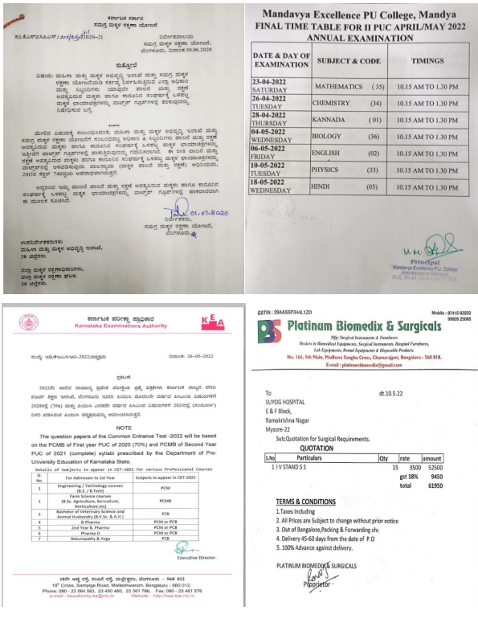
Dataset
Various types of documents we used

Slide 11
Proposed Methodology
In this project, we proposed various machine learning approaches to detect the handwritten signature in document images, they are
Connected component analysis,
Signature Extraction using Contour Height & Contour width Heuristic
Detecting signatures through HSV Color Space.
SIFT feature matching
Template matching

Slide 12
Proposed Methodology
We do a comparative analysis between Connected component analysis, Signature Extraction using Contour Height & Contour width Heuristic Detecting signatures through HSV Colour Space.
To locate the signature in a document using SIFT feature matching and Template matching, from that we got to know which detects the signature between them.

Slide 13
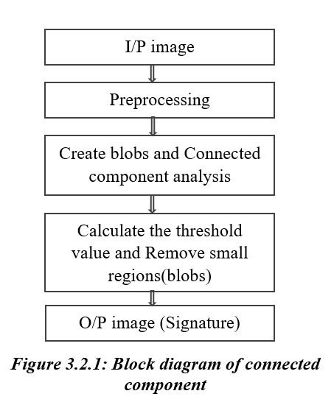
Proposed Methodology
1. Connected components Method:
Preprocessing:
At first, we read the image and then resize it to 1280 X 1280, to remove noise and enhance this image we used the Otsu method. If there are any lines or tables in the image we remove them by applying morphological open using a horizontal and vertical kernel. After this, the document is free from noise.

Slide 14
Proposed Methodology
Connected Component Analysis:
To store all the features of signature, blob’s were created. Since our intension is to extract signature from the document, it is necessary to separate foreground from background.
Using connected component analysis any discontinuity present in the signature is filled.
Normally area of the signature is more when compared with all the blobs and these small blobs are removed using region props
In order to eliminate smaller areas called blobs, region props are used which is performed by fixing some threshold values and finally the area i.e, a blob which is left in the documents is considered as a signature.

Slide 15
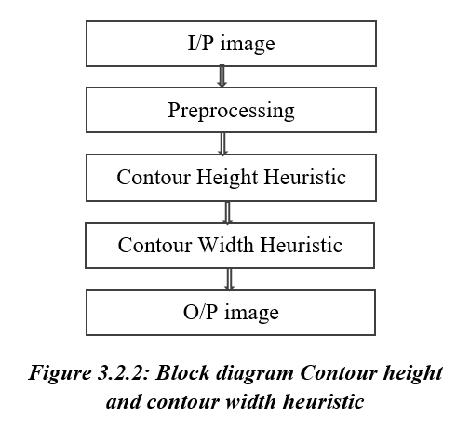
Proposed Methodology
2. Signature extraction using Contour Height and Contour Width Heuristic method:
Preprocessing:
First we read the image then resize it to 1280X1280.
Since the document is real-time which has different background like marginal noise clutter noise, rule noise and other background noise.
To reduce that kind of noise in image we use Otsu method then if there is any table or lines we remove them using hough transforms

Slide 16
Proposed Methodology
Contour height and width heuristic:
In this phase, first we apply Contour height heuristic, here we Create a blank image of the same dimension of the original image. By finding the average height from all the contour heights we draw those which are above the average on the blank image. We got the signature contours along with noise.
we apply Contour width to extract only signature, here also we create a blank image and copy the signature to a blank image.

Slide 17
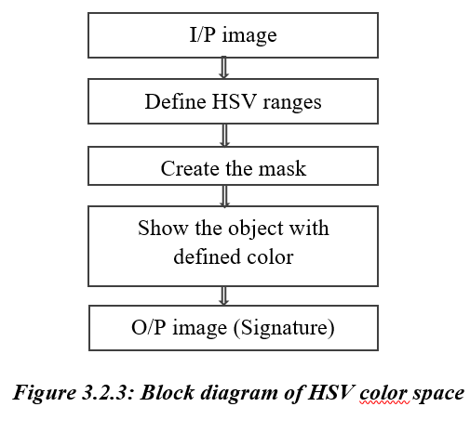
Proposed Methodology
3. Detecting signatures through HSV color space:
Create Mask and Extract Signature:
At first we read images and resize it to 1280 X 1280.
Then we create a mask of signature by selecting a possible range of HSV colors that signature can have.
After applying HSV ranges we get signature of color to the matched HSV ranges we defined on mask.
Then we draw bounded box on original image and crop the signature.

Slide 18
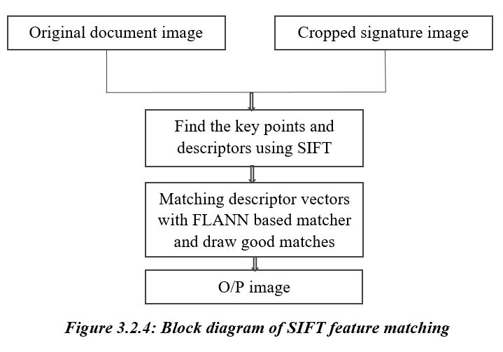
Proposed Methodology
4. SIFT Feature Matching:
Feature Extraction and Matching:
Taking two images as input one is original image and other is cropped image which consists of only signature. To generate SIFT features to these images first we have to initiate SIFT object then we use then function detectAndCompute to get the keypoints and the descriptors.
To match the features from a cropped signature image with features from original image we will use FLANN-based matcher. To get accurate result we will draw lines between the features that good matches. Then we get predicted image.

Slide 19
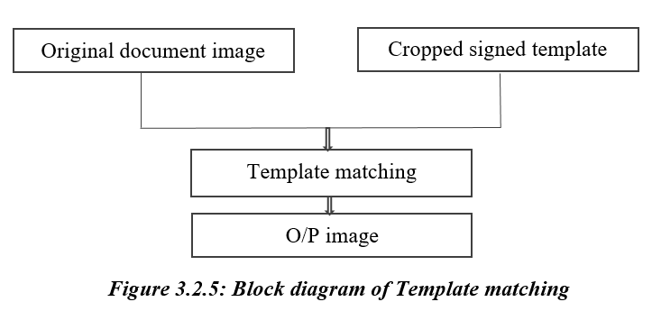
Proposed Methodology
5. Template matching:
Basically template matching is a method of searching and finding the location of the template image in an original image.
Here we pass two images as input one is original image and other is cropped signature template image.
The template and patch input image are compared. The result obtained are compared with threshold. If the result is greater than the threshold, the portion will be marked as detected.

Slide 20




Results
Connected Component Method:
Original Image
Preprocessed Image
Signature detected image
Output image

Slide 21


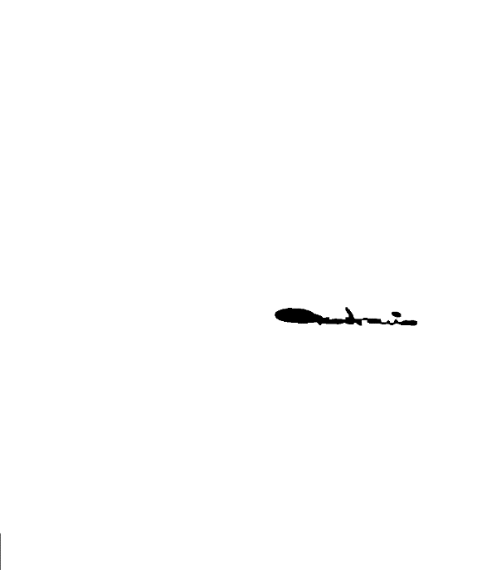


Results
Signature extraction using Contour Height and Contour Width heuristic method:
Original Image
Preprocessed
Image after applying Height heuristic
Image after applying width heuristic
Signature detected Image

Slide 22
Results
Signature extraction using Contour Height and Contour Width heuristic method:
Original Image
Preprocessed
Image after applying Height heuristic
Image after applying width heuristic
Signature detected Image

Slide 23
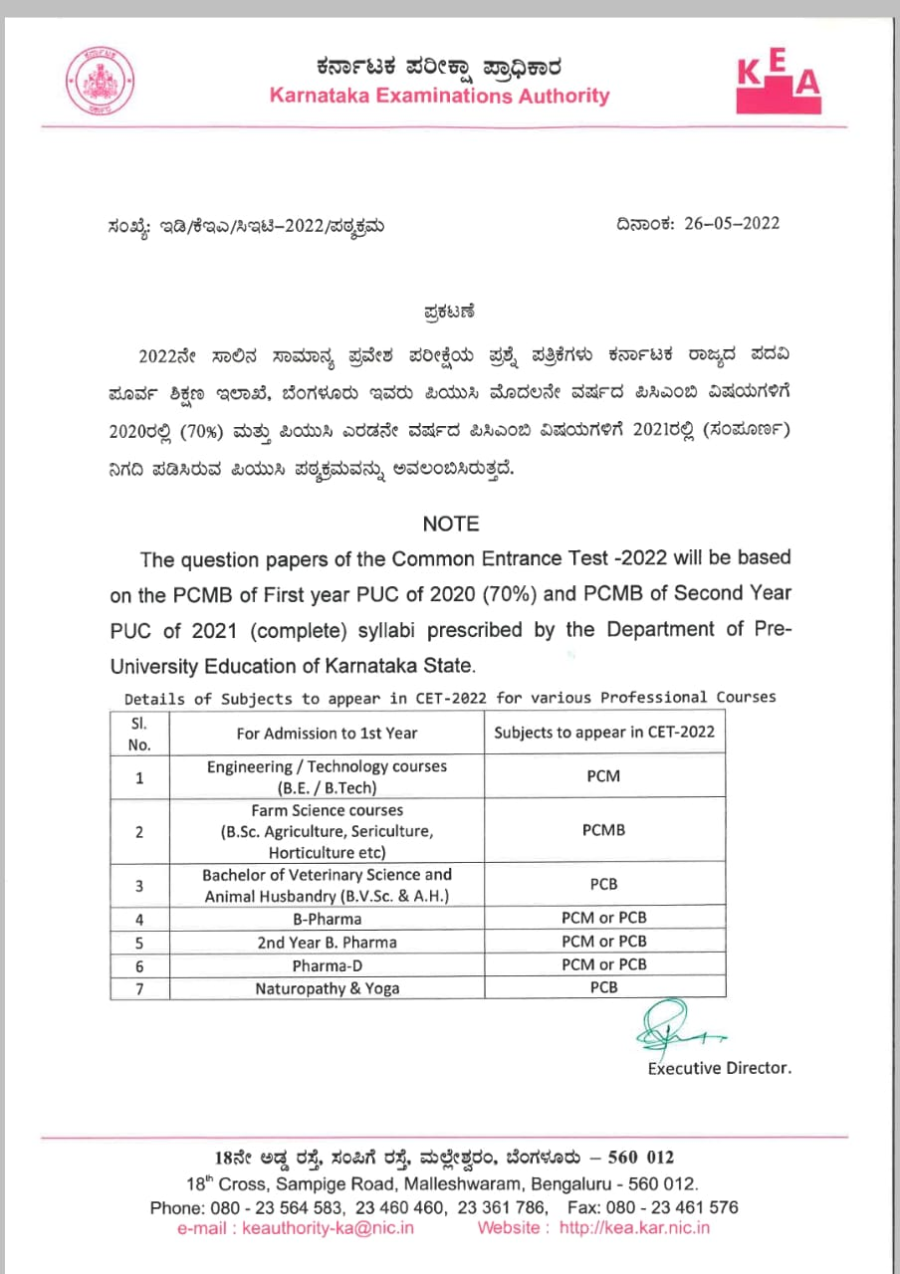


Results
Detecting signatures through HSV color space :
Original image
Mask image
Signature detected image

Slide 24
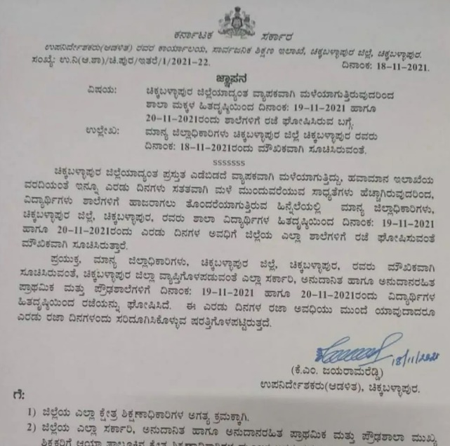

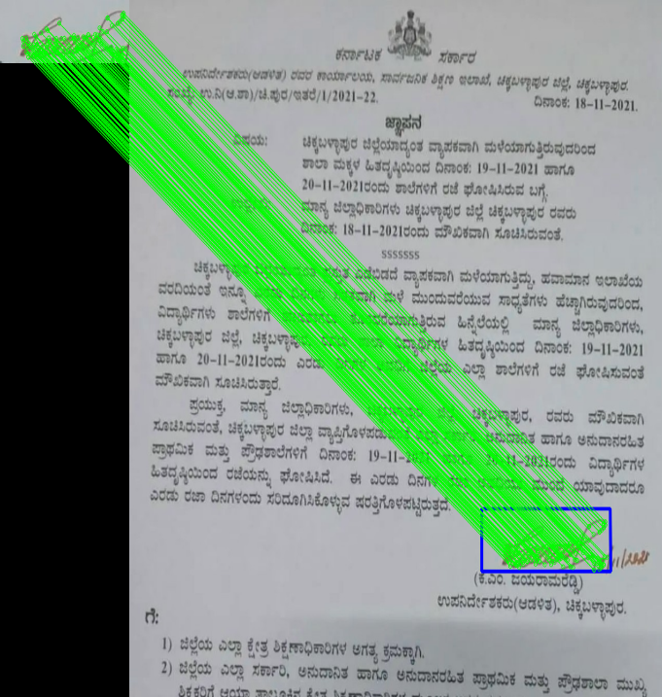
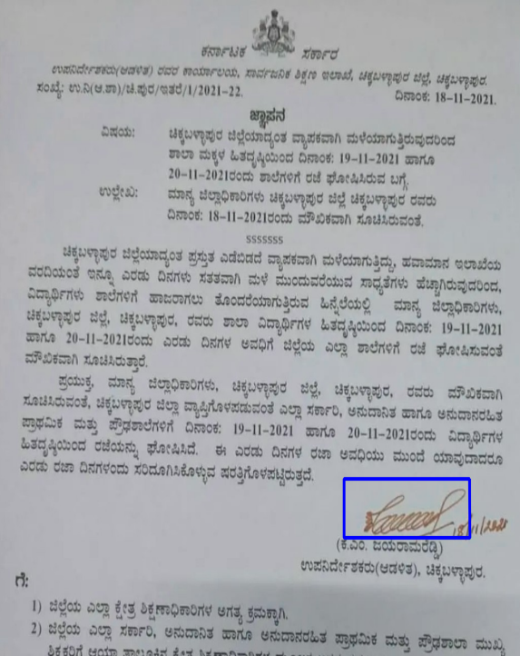
Results
SIFT Feature Matching :
Original image
Template image
Matching
Signature detected image

Slide 25
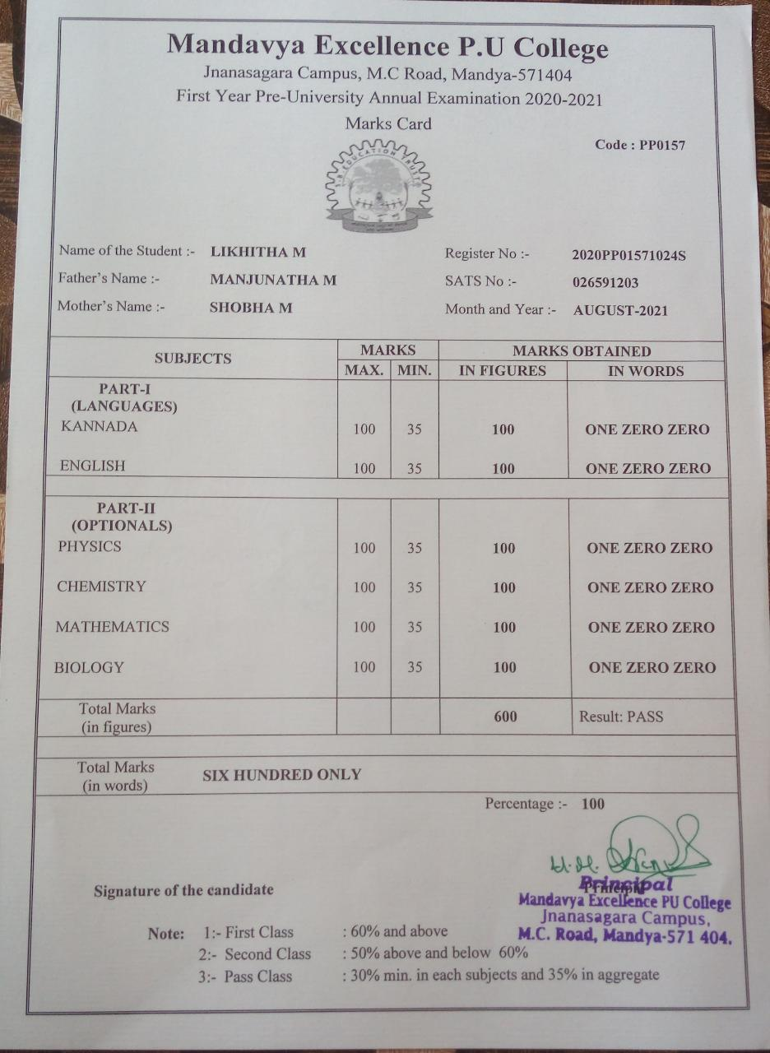
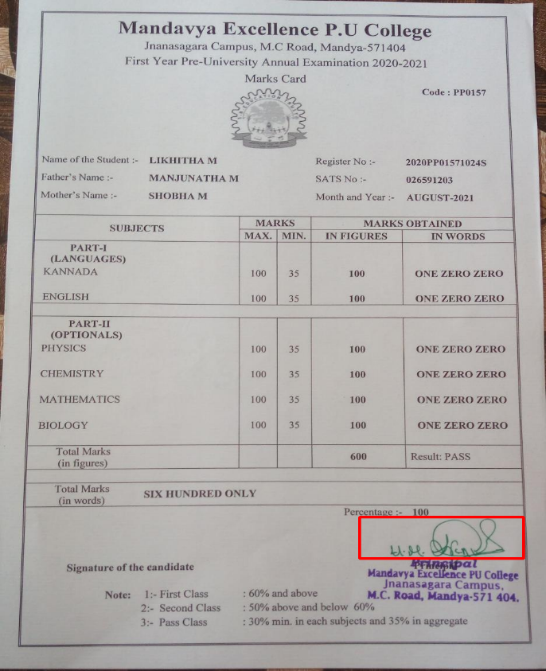

Results
Template Matching :
Original image
Template image
Signature detected image

Slide 26
Experimental Observations
In this project, while experimenting all the approaches we observed that:
In Connected component analysis, signature is detected and extracted with the same accuracy even when the document is given in any orientation.
Contour Height and Width heuristic detect the signature even when the document image is vertically flipped.
In HSV color space method, signature is detected and extracted with the same accuracy even when the document is given in any orientation.
SIFT feature matching results good in locating the signature even when the document image is in any orientation.
In Template matching method, a slight change in size or orientation variations can cause problems.
For experimentation, we used own real-time document images. The images are given to the proposed algorithm and performance is evaluated by measuring the Accuracy.

Slide 27
Experimental Observations
Table 1: Results obtained for the methodologies
Method | No. of images used for the experiment | No of output images obtained | Accuracy
CCA | 100 | 94 | 94 %
Contour Height and Width heuristic | 100 | 85 | 85 %
HSV color space | 100 | 80 | 80 %
Table 2: Results obtained for the methodologies
Method | No. of images used for the experiment | No of output images obtained | Accuracy
SIFT feature matching | 100 | 97 | 97 %
Template matching | 100 | 92 | 92 %

Slide 28
Conclusion
In this project, we presented approaches for detecting and extracting signatures from real-time document images. Our work involves five methodologies for detecting the signature from documents, a comparative analysis was performed between the Connected component, Signature Extraction using Contour Height & Contour width Heuristic, and Detecting signatures through HSV Color Space methods. Along with this we also used SIFT feature matching and Template matching techniques to locate signatures in documents and found the best among them.
It is observed that the Connected component method gives more significant results with 94 % of accuracy for the number given set of real-time documents.

Slide 29
Conclusion
With the highest accuracy of 97 %, it is evident that SIFT feature matching is more efficient to locate the signature in a document than Template matching.
A refined method of detecting and extracting signatures was discussed which can further increase in accuracy of detecting and extraction.

Slide 30
Thank You

